Slide 1
How to Teach Computers to Recognize Things S1: What, Why, How
Dr. Du Pengfei
SVS/DMD
27 June 2024

Slide 2
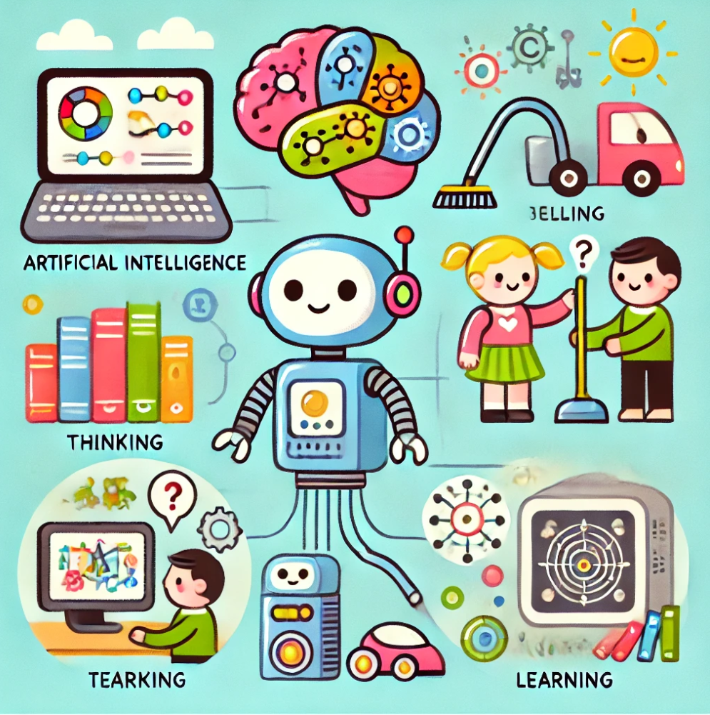
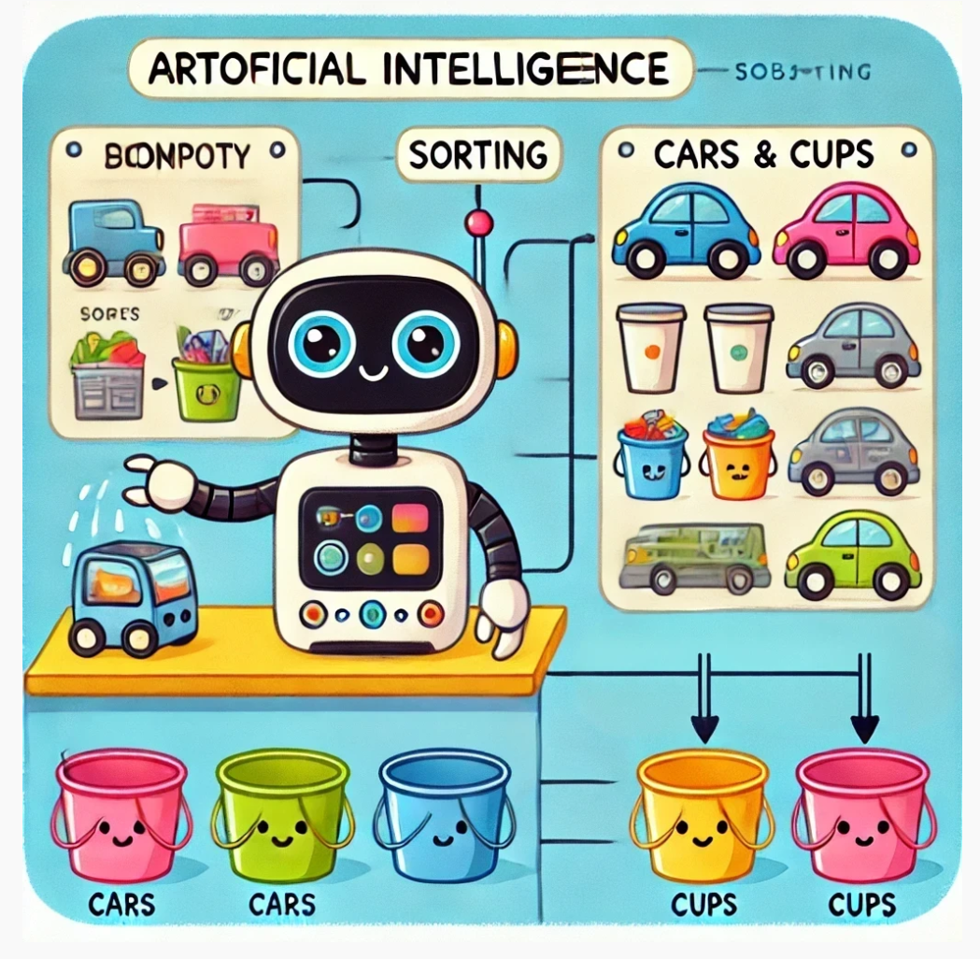
Agenda
First half: Warm-up: What is Artificial Intelligence?
Second half: Our First A.I. Training Projects: Cup Or Car
Notes:
https://www.youtube.com/watch?v=2hXG8v8p0KM

Slide 3
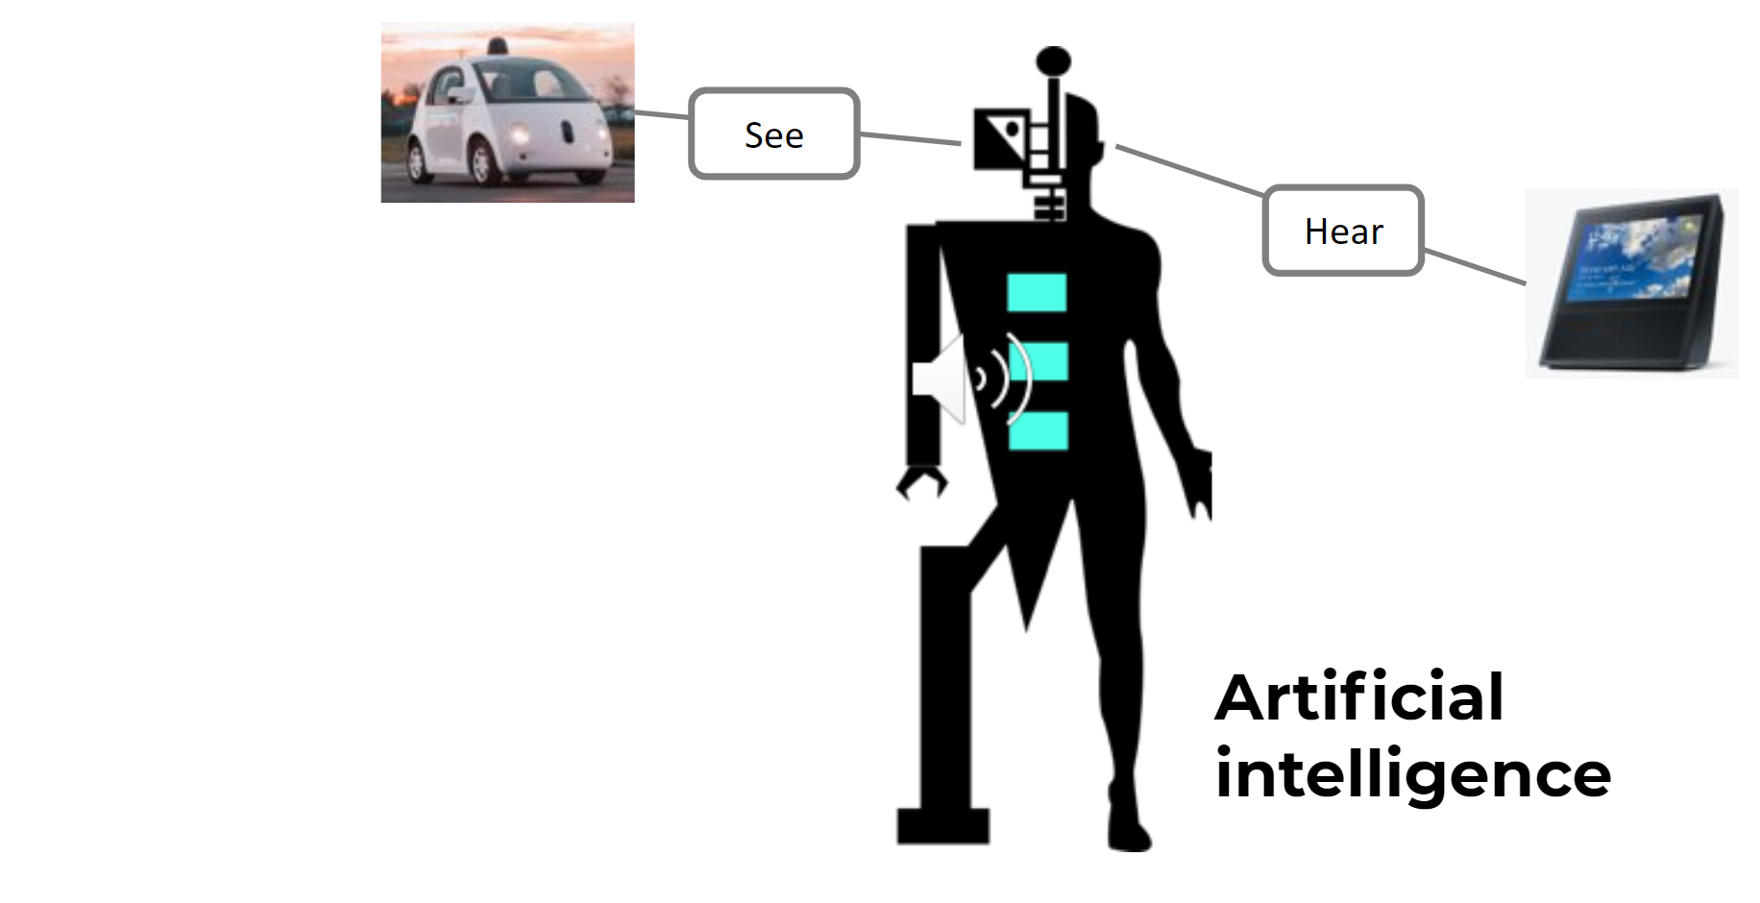
Warm UP: Machine Learning OR AI
https://www.youtube.com/watch?v=KHbwOetbmbs
AI (Artificial Intelligence) == Machine Learning
Man-made
Sense,
Think / Reason, Act & Adapt
Notes:
https://www.youtube.com/watch?v=2hXG8v8p0KM

Slide 4
Warm UP: Machine Learning OR AI
https://www.youtube.com/watch?v=KHbwOetbmbs
AI (Artificial Intelligence) == Machine Learning
Man-made
Sense,
Think / Reason, Act & Adapt
AI is Program to Sense, Reason, Act and Adapt
Quick Share-out: Where have you seen or experienced artificial intelligence in your lives?
Examples from the video include:
email filters
auto-complete text
video recommendation systems
voice recognition
translation apps
digital assistants
Image/video recognition
https://chat.openai.com/auth/login?next=%2F
Notes:
https://www.youtube.com/watch?v=2hXG8v8p0KM

Slide 5
Warm UP: Machine Learning OR AI
AI (Artificial Intelligence) == Machine Learning
Man-made
Sense,
Think / Reason, Act & Adapt
AI is Program to Sense, Reason, Act and Adapt
Quick Share-out: Where have you seen or experienced artificial intelligence in your lives?
Examples from the video include:
email filters
auto-complete text
video recommendation systems
voice recognition
translation apps
digital assistants
Image/video recognition
Our Program Agenda
P6 2~3 Sessions: How to Teach Computers to Recognize Natural Language
P5 4~5 Sessions: How to Teach Computers to Recognize Things
Notes:
https://www.youtube.com/watch?v=2hXG8v8p0KM

Slide 6
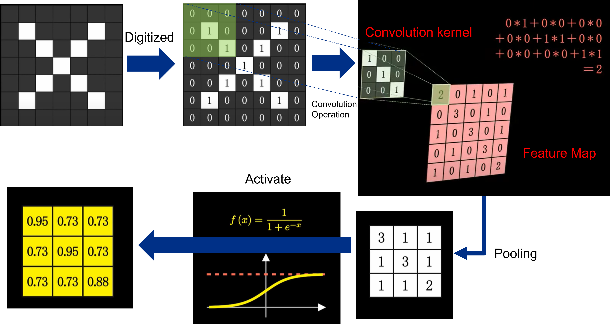
Warm UP: Machine Learning in Computer Vision
https://www.youtube.com/watch?v=2hXG8v8p0KM
Quick Share-out:
How computers see our world?
Pixels (Numerical), Features,
What is training?
Learning Process == Keep Finding Proper Features of Targets
Notes:
https://www.youtube.com/watch?v=2hXG8v8p0KM

Slide 7
Hands on: Our First AI Project: Cups OR Cars

Slide 8
Warm UP: Machine Learning in Computer Vision
General steps of building A.I. in our real-world:
Image Capture → Annotation → Training → Testing
Teacher preparing textbooks
attending class
Examination

Slide 9
Warm UP: Machine Learning in Computer Vision

Slide 10
Hands on: Our First AI Project
https://www.youtube.com/watch?v=x2mRoFNm22g
Data is Code as well!!
A.I. only learns what we taught !
Bear in Mind while conducting your first AI Project:
Is Data sufficient for training?
Is Data of high quality including all scenarios without bias?
Notes:
https://www.youtube.com/watch?v=2hXG8v8p0KM

Slide 11
Wrap UP: A.I. Impact on Society
Quick Share-out: Based on the skills and knowledge you learned today, any ideas of applications you want to build AI to do?
https://www.youtube.com/watch?v=ng4c1g3COfs
Artificial intelligence systems learn from the data we give it, but that data could be opinion-based or biased.
Think of a time where machine learning might have got something wrong in the real world?
https://www.youtube.com/watch?v=_-E36V73VOg
Notes:
https://www.youtube.com/watch?v=2hXG8v8p0KM

Slide 12
S2 Preparation
Bring a Thumb Drive!

Slide 13
Contact: Du Pengfei
du_pengfei@SIMTech.a-star.edu.sg

Slide 14
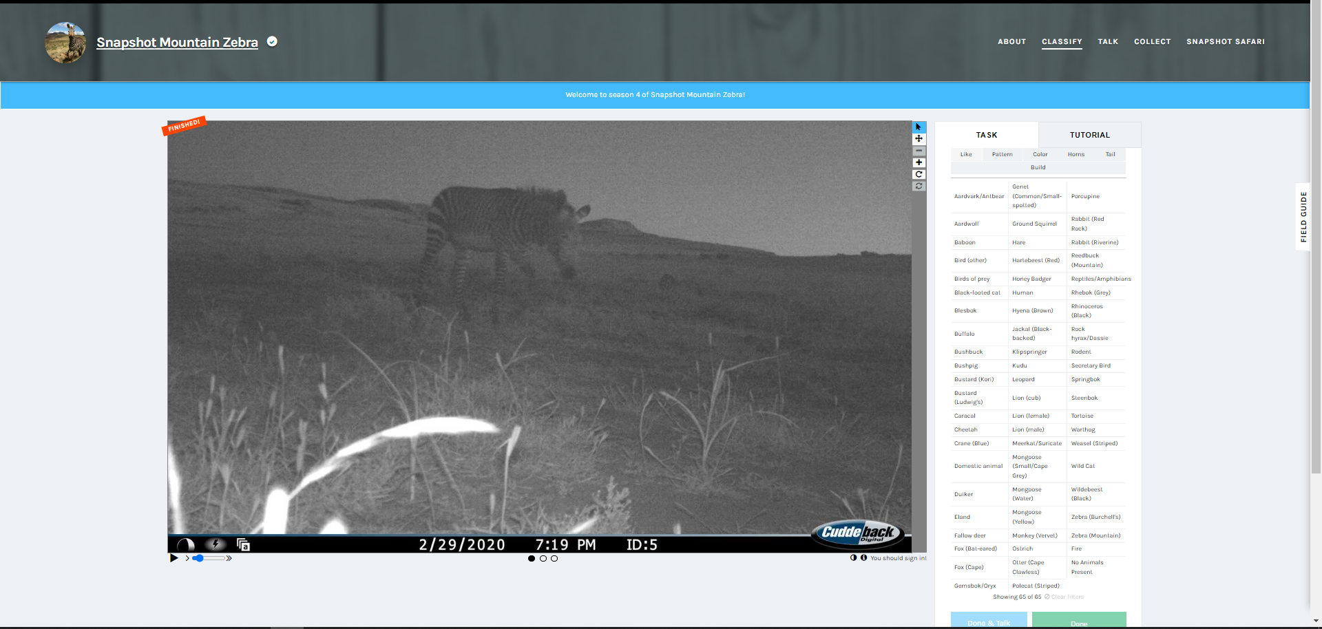
Extension: Help Classify Animals at Mountain Zebra National Park
https://www.zooniverse.org/projects/meredithspalmer/snapshot-mountain-zebra/classify?reload=0&workflow=11445
Help Classify Animals at Mountain Zebra National Park
Snapshot Safari has placed hundreds of hidden cameras across southern Africa, capturing millions of images of beautiful and rare animals.
Students can help protect the endangered Cape Mountain Zebra by classifying the different animals in these images. You can read about the project here or click below to give it a try!
Notes:
https://www.youtube.com/watch?v=2hXG8v8p0KM

